Slide 1
Software Configuration management
CO5: Student will be able to demonstrate and evaluate real time projects with respect to software engineering principles

Slide 2
What is Change Management
Also called software configuration management (SCM)
It is an umbrella activity that is applied throughout the software process
It's goal is to maximize productivity by minimizing mistakes caused by confusion when coordinating software development
SCM identifies, organizes, and controls modifications to the software being built by a software development team
SCM activities are formulated to identify change, control change, ensure that change is being properly implemented, and report changes to others who may have an interest

Slide 3
Origins of Software Change
Errors
New business or market conditions
New customer needs
Reorganization or business growth/downsizing
Budgetary or scheduling constraints

Slide 4
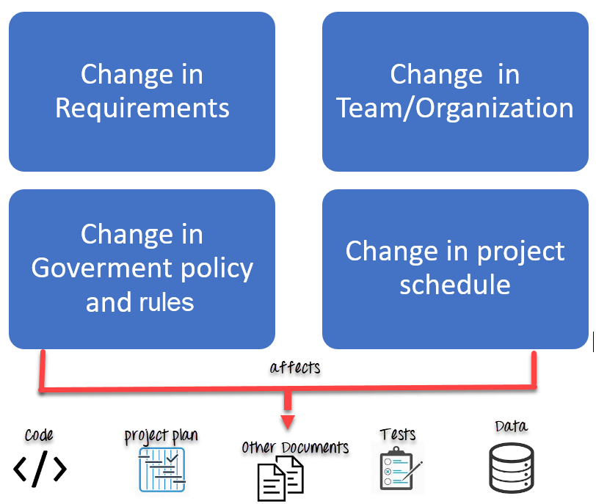

Slide 5
Elements of a Configuration Management System
Configuration elements
  A set of tools coupled with a file management (e.g., database) system that enables access to and management of each software configuration item
Process elements
  A collection of procedures and tasks that define an effective approach to change management for all participants
Construction elements
  A set of tools that automate the construction of software by ensuring that the proper set of valid components (i.e., the correct version) is assembled
Human elements
  A set of tools and process features used by a software team to implement effective SCM

Slide 6
Baseline
An SCM concept that helps practitioners to control change
IEEE Definition:
A specification or product that has been formally reviewed and agreed upon, and that thereafter serves as the basis for further development, and that can be changed only through formal change control procedures
It is a milestone in the development of software and is marked by the delivery of one or more computer software configuration items (CSCIs) that have been approved as a consequence of a formal technical review
A CSCI may be such work products as a document , a test suite, or a software component

Slide 7
Baselining Process
A series of software engineering tasks produces a CSCI
The CSCI is reviewed and possibly approved
The approved CSCI is given a new version number and placed in a project database (i.e., software repository)
A copy of the CSCI is taken from the project database and examined/modified by a software engineer
The baselining of the modified CSCI goes back to Step #2

Slide 8
The SCM Repository

Slide 9
Automated SCM Repository (Functions and Tools)
Versioning
Requirements
tracing
Functions
Data integrity
Information sharing
Tool integration
Data integration
Methodology enforcement
Document standardization
SCM Repository
Dependency
tracking
Configuration
management
Change
management
Audit
trails

Slide 10
Functions of an SCM Repository
Data integrity
  Validates entries, ensures consistency, cascades modifications
Information sharing
  Shares information among developers and tools, manages and controls multi-user access
Tool integration
  Establishes a data model that can be accessed by many software engineering tools, controls access to the data
Data integration
  Allows various SCM tasks to be performed on one or more CSCIs
Methodology enforcement
  Defines an entity-relationship model for the repository that implies a specific process model for software engineering
Document standardization
  Defines objects in the repository to guarantee a standard approach for creation of software engineering documents

Slide 11
Toolset Used on a Repository
Versioning
  Save and retrieve all repository objects based on version number
Dependency tracking and change management
  Track and respond to the changes in the state and relationship of all objects in the repository
Requirements tracing
  (Forward tracing) Track the design and construction components and deliverables that result from a specific requirements specification
  (Backward tracing) Identify which requirement generated any given work product
Configuration management
  Track a series of configurations representing specific project milestones or production releases
Audit trails
  Establish information about when, why, and by whom changes are made in the repository

Slide 12
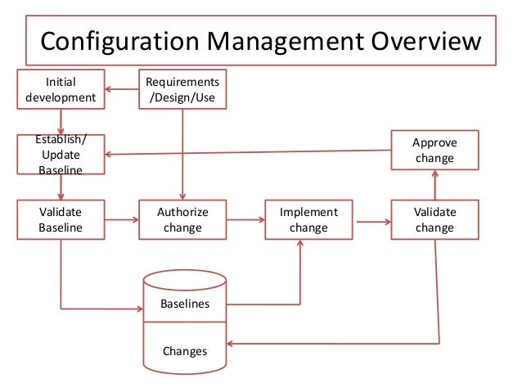

Slide 13
The SCM Process

Slide 14
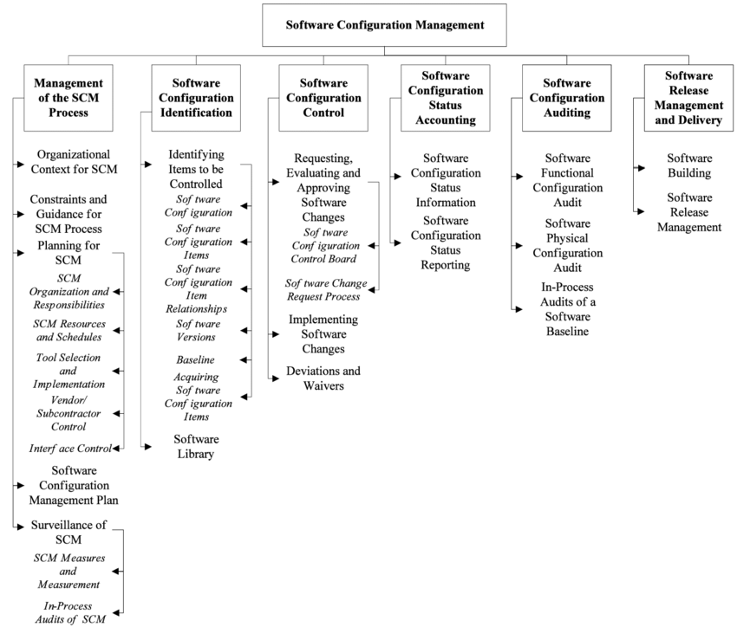

Slide 15
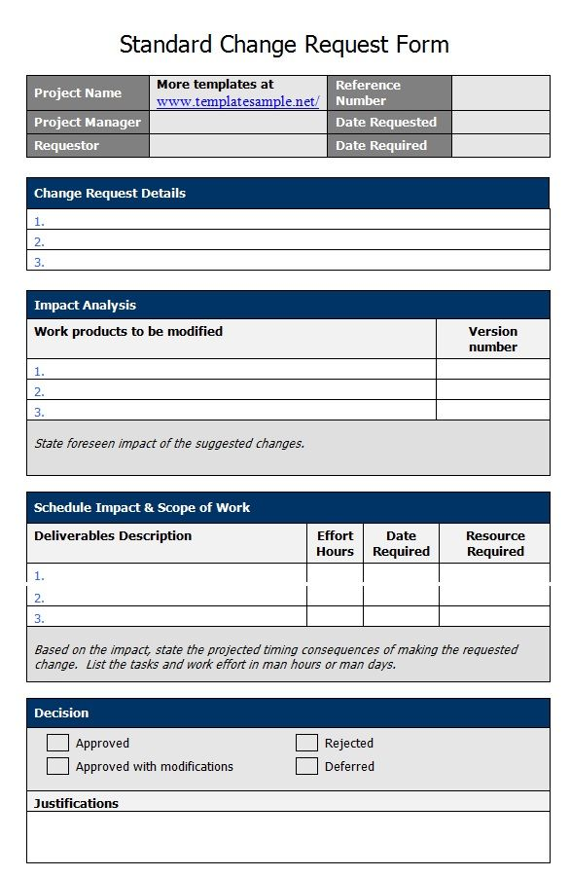

Slide 16
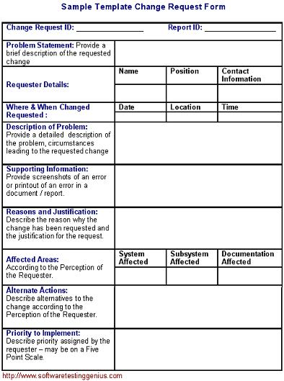

Slide 17
Primary Objectives of the SCM Process
Identify all items that collectively define the software configuration
Manage changes to one or more of these items
Facilitate construction of different versions of an application
Ensure the software quality is maintained as the configuration evolves over time
Provide information on changes that have occurred

Slide 18
SCM Questions
How does a software team identify the discrete elements of a software configuration?
How does an organization manage the many existing versions of a program (and its documentation) in a manner that will enable change to be accommodated efficiently?
How does an organization control changes before and after software is released to a customer?
Who has responsibility for approving and ranking changes?
How can we ensure that changes have been made properly?
What mechanism is used to appraise others of changes that are made?

Slide 19
SCM Tasks
Status reporting
Configuration auditing
Version control
Change control
Identification
CSCI
CSCI
CSCI
CSCI

Slide 20
SCM Tasks (continued)
Concentric layers (from inner to outer)
  Identification
  Change control
  Version control
  Configuration auditing
  Status reporting
CSCIs flow outward through these layers during their life cycle
CSCIs ultimately become part of the configuration of one or more versions of a software application or system

Slide 21
Identification Task
Each CSCI must be named and identified as objects.
Objects start out as basic objects and are then grouped into aggregate objects into the database repository
Each object has a set of distinct features that identify it
  A name that is unambiguous to all other objects
  A description that contains the CSCI type, a project identifier, and change and/or version information
  List of resources needed by the object
  The object realization (i.e., the document, the file, the model, etc.)

Slide 22
Change Control Task
A change request is submitted to a configuration control authority, which is usually a change control board (CCB)
  The request is evaluated for technical merit, potential side effects, overall impact on other configuration objects and system functions, and projected cost in terms of money, time, and resources
An engineering change order (ECO) is issued for each approved change request
  Describes the change to be made, the constraints to follow, and the criteria for review and audit
The baselined CSCI is obtained from the SCM repository
  Access control governs which software engineers have the authority to access and modify a particular configuration object
  Synchronization control helps to ensure that parallel changes performed by two different people don't overwrite one another

Slide 23
Version Control Task
Version control is a set of procedures and tools for managing the creation and use of multiple occurrences of objects in the SCM repository
Required version control capabilities
  An SCM repository
  A version management capability
  A make facility
  Issues tracking (bug tracking) capability
The SCM repository maintains a change set
  Serves as a collection of all changes made to a baseline configuration
  Used to create a specific version of the software
  Captures all changes to all files in the configuration along with the reason for changes and details of who made the changes and when

Slide 24
Configuration Auditing Task
In order to ensure changes has been properly implemented or not, two activities are carried out:
Formal Technical Review
Software Configuration Audit
Configuration auditing is an SQA activity that helps to ensure that quality is maintained as changes are made
It complements the formal technical review and is conducted by the SQA group
A configuration audit ensures that
  The correct CSCIs (by version) have been incorporated into a specific build
  That all documentation is up-to-date and consistent with the version that has been built

Slide 25
Status Reporting Task
The status reporting focuses on communication of the changes to all people in an organization involved with the changes and answers following:
What happened?
Who did it?
When did it happen?
what else will be affected?

Slide 26
Summary
Introduction
SCM Repository
SCM Process
  Identification
  Change control
  Version control
  Configuration auditing
  Status reporting

